Slide 1

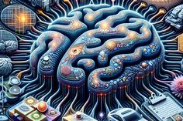
ST
Classification with CNN
Fashion MNIST
Classification with CNN
-By Sreehari.A

Slide 2
OBJECTIVES
Data Preprocessing
Model Building
Model Development
Testing

Slide 3
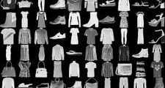
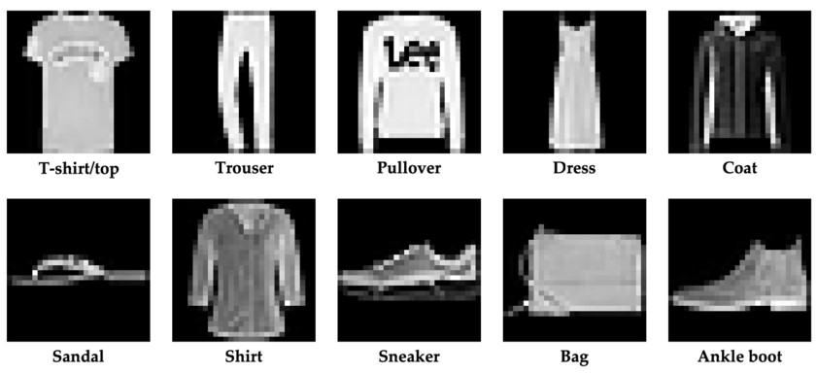
DATASET

Slide 4
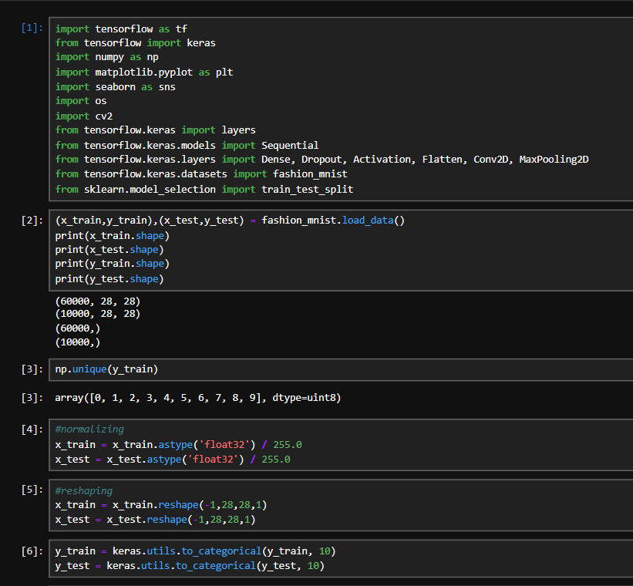

Slide 5
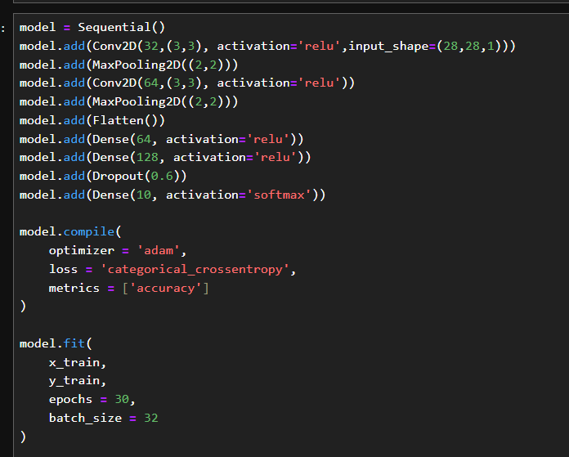

Slide 6
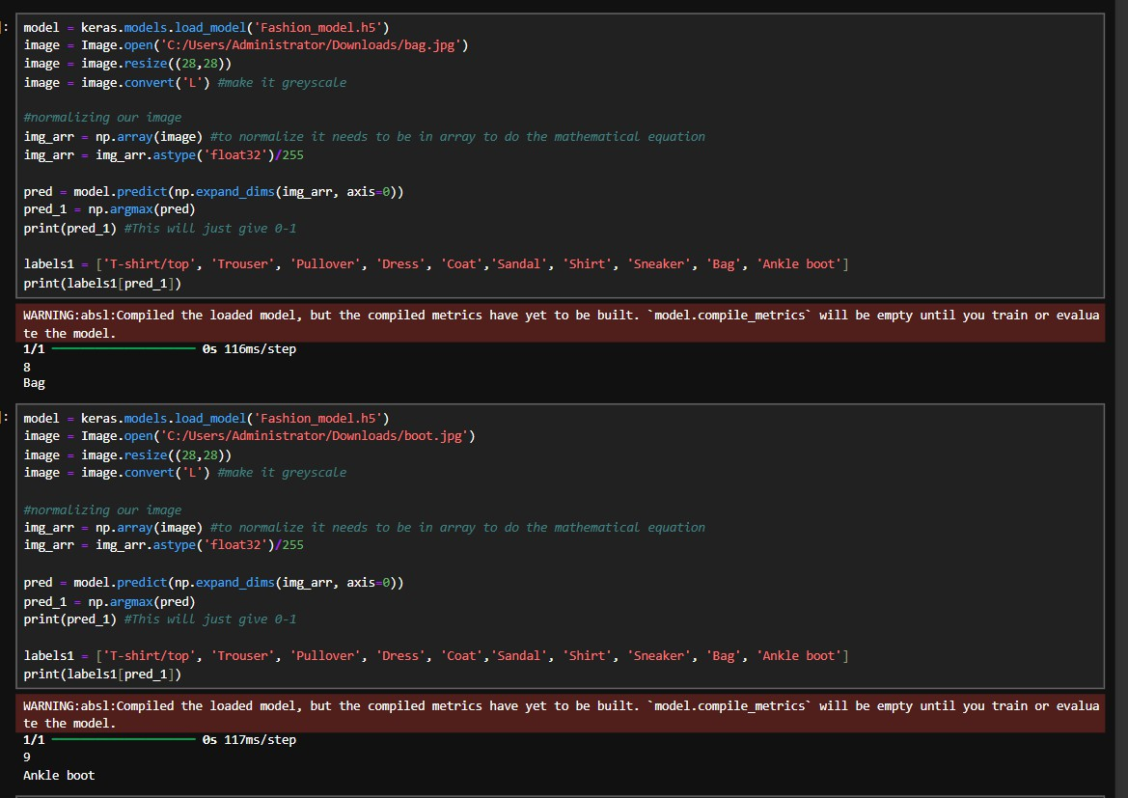
Testing

Slide 7
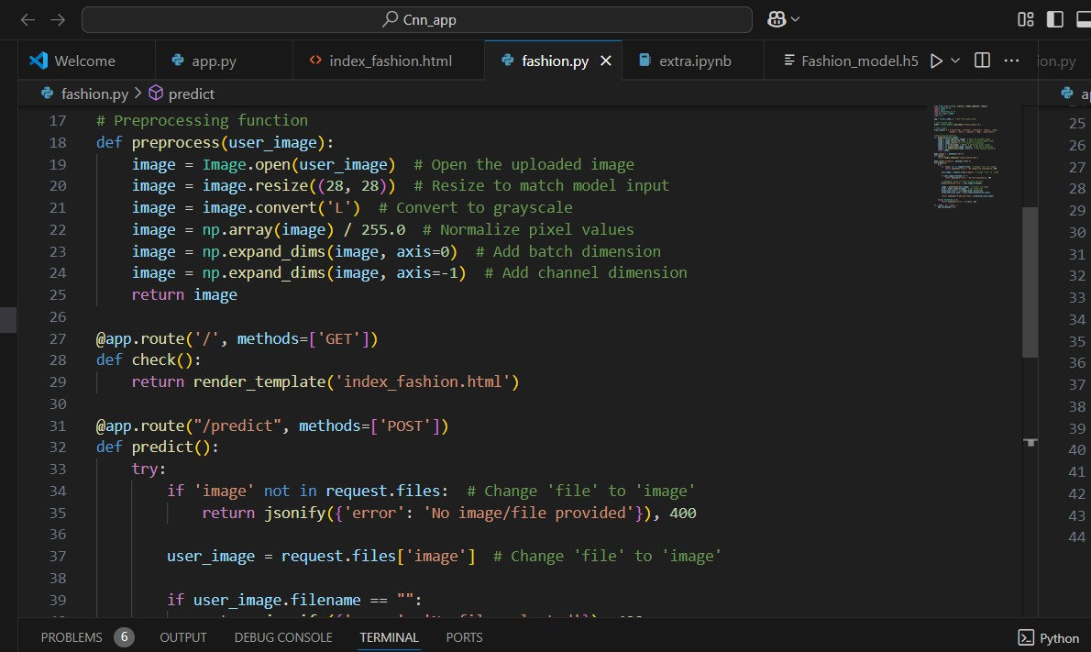
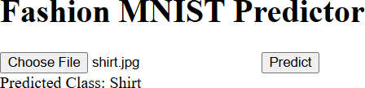
Model Deployment

Slide 8
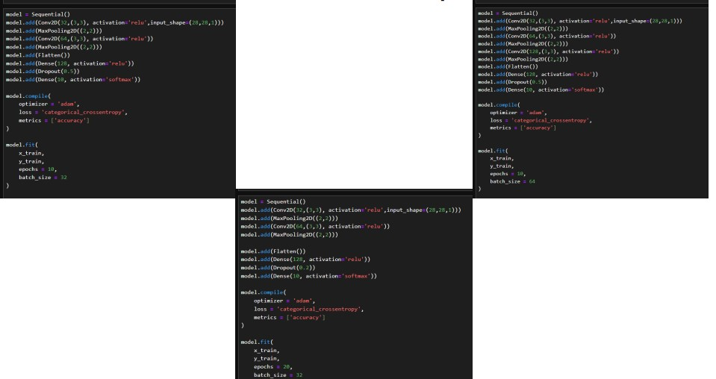
Some other models for comparison

Slide 9
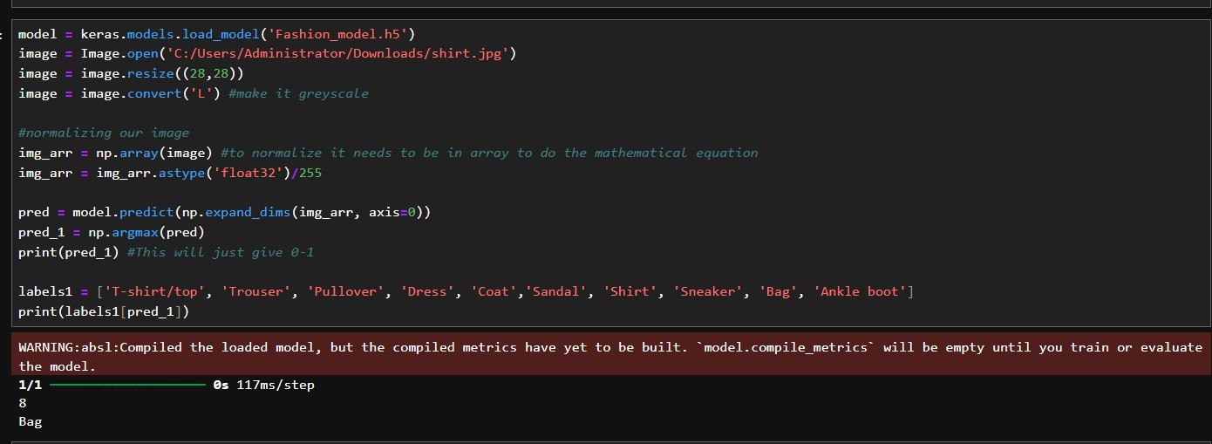
Concluding the model selection
BCZ OF
Reduced Overfitting Higher accuracy
Optimal number of layers Accurate result Reproductibility

